Slide 1
CHAPTER 9
OBJECT-ORIENTED CONCEPTS AND PRINCIPLES

Slide 2
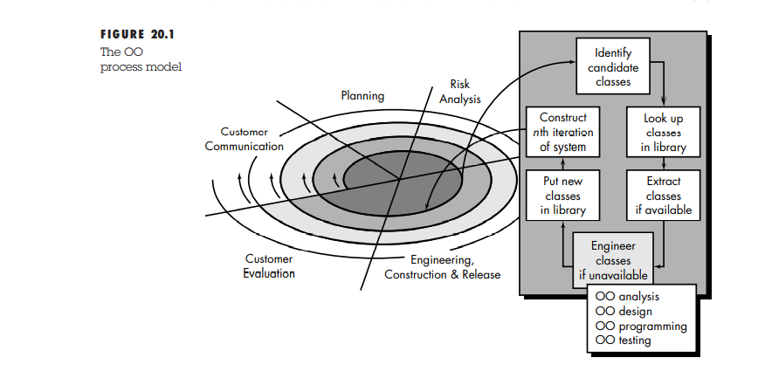
The OO Process model

Slide 3
OO Process model
The OO process moves through an evolutionary spiral that starts with customer communication.
.Planning and risk analysis establish a foundation for the OO project plan
The technical work associated with OO software engineering follows the iterative path shown in the shaded box.
OO software engineering emphasizes reuse.

Slide 4
OO Process model
Therefore, classes are “looked up” in a library (of existing OO classes) before they are built.
When a class cannot be found in the library, the software engineer applies object-oriented analysis (OOA), object-oriented design (OOD), object-oriented programming (OOP), and object-oriented testing (OOT) to create the class and the objects derived from the class.
The new class is then put into the library so that it may be reused in the future

Slide 5
Definition of Object and Class
Class : A class is a generalized description that describes a collection of a similar objects.
Object : Instance of Class is called object
One widely used approach to problem solving takes an object-oriented viewpoint

Slide 6
The Object Oriented Paradigm
For many years, the term object oriented (OO) was used to denote a software development approach that used one of a number of object-oriented programming languages Java, C++,
Today, the OO paradigm encompasses a complete view of software engineering.

Slide 7
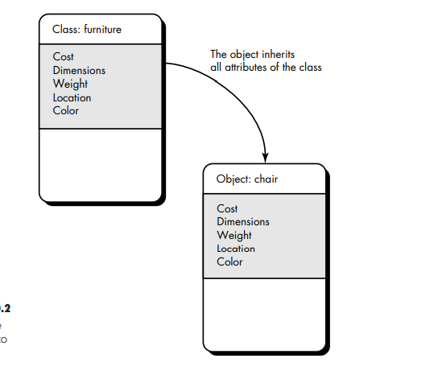
Inheritance

Slide 8
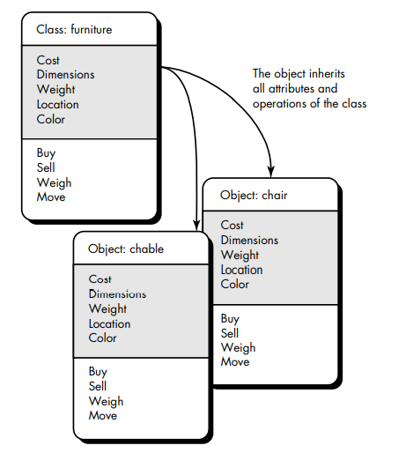
Inheritance

Slide 9
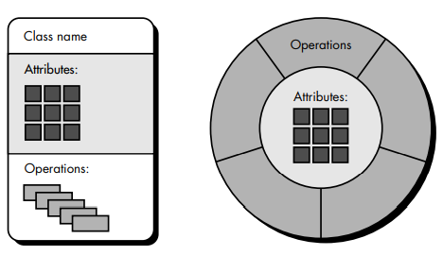
Class and Object
An Alternative way to represent class and object

Slide 10
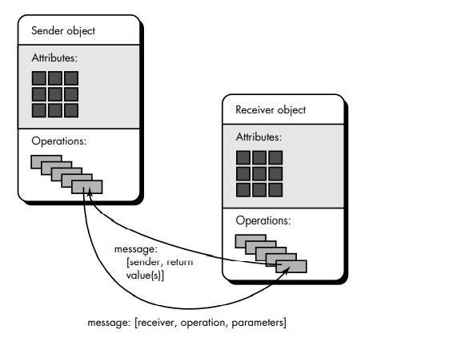
Message Passing Between Class

Slide 11
IDENTIFYING THE ELEMENTS OF AN OBJECT MODEL
1. Identifying Classes and Objects
Objects can be:-
External Entities
• Things
• Occurrences or events
• Roles
• Organizational units
• Places
• Structure

Slide 12
IDENTIFYING THE ELEMENTS OF AN OBJECT MODE
2. Specifying Attributes
Attributes are chosen by examining the problem statement, looking for things that fully define an object and make it unique.

Slide 13
IDENTIFYING THE ELEMENTS OF AN OBJECT MODE
3. Defining the operation
Although many different types of operations exist, they can generally be divided into three broad categories:
operations that manipulate data in some way (e.g., adding, deleting, reformatting, selecting),
operations that perform a computation,
operations that monitor an object for the occurrence of a controlling event

Slide 14
IDENTIFYING THE ELEMENTS OF AN OBJECT MODE
3. Finalizing the Object Definition
The definition of operations is the last step in completing the specification of an object

Slide 15
OO Project Metrics and Estimation
Conventional software project estimation -- (LOC) and function points (FP)
OOP Project Metrics is based on:
1.Number of scenario scripts (initiator, action and participator)
2.Number of key classes
3.Number of support classes
4.Average number of support classes per key class
5.Number of subsystems.

